Slide 1
Mechanisms in the Cleaning of Aluminium Melts with Flux Preparations
??? OCCASION, DATE, VENUE ???
??? SPEAKER ???

Slide 2
Mechanisms in the Cleaning of Aluminium Melts with Flux Preparations
I. Impurities in the melt
II. Impurities on furnace and crucible walls
IV. Impurities due to
foreign metals
III. Basics of flux preparations
Impurities in the melt
Impurities on furnace and crucible walls
Basics of flux preparations
Impurities due to foreign metals

Slide 3
Mechanisms in the Cleaning of Aluminium Melts with Flux Preparations
I. Impurities in the melt
II. Impurities on furnace and crucible walls
IV. Impurities due to
foreign metals
III. Basics of flux preparations
Impurities in the melt
Impurities due to oxides and hydrogen gas
Removing oxides with flux preparations
Impurities on furnace and crucible walls
Basics of flux preparations
Impurities due to foreign metals

Slide 4
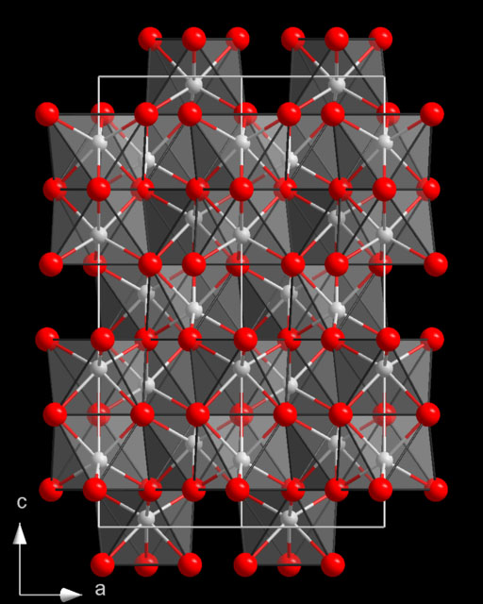
1. Impurities due to oxides and hydrogen 1.1 General information
I. Impurities in the melt
II. Impurities on furnace and crucible walls
IV. Impurities due to
foreign metals
III. Basics of flux preparations
Source of hydrogen and oxides
in the aluminium
is normally
water from the athmosphere
Source of hydrogen and oxides
aluminium + water
aluminium oxides + hydrogen
structure of corundum

Slide 5
1. Impurities due to oxides and hydrogen 1.1 General information
I. Impurities in the melt
II. Impurities on furnace and crucible walls
IV. Impurities due to
foreign metals
III. Basics of flux preparations
As a rule, hydrogen and oxides are simultaneously present in the melt
aluminium oxid
hydrogen

Slide 6
1. Impurities due to oxides and hydrogen 1.2 Hydrogen in aluminium
I. Impurities in the melt
II. Impurities on furnace and crucible walls
IV. Impurities due to
foreign metals
III. Basics of flux preparations
Sievert´s Law:
l in ml/100g Al
solubility[l] = function (pressure [p_{H2} ], temperature [T])
T in °C

Slide 7
I. Impurities in the melt
II. Impurities on furnace and crucible walls
IV. Impurities due to
foreign metals
III. Basics of flux preparations
1. Impurities due to oxides and hydrogen 1.3 Compound of aluminium und water
water (H₂O)
aluminium (Al)
with molecular hydrogen (H₂) in pores and
aluminium oxide (Al₂O₃₎
aluminium (Al)
aluminium oxide
(Al₂O₃)
aluminium (Al)
with atomic hydrogen (H)
aluminium
oxygen
hydrogen

Slide 8
1. Impurities due to oxides and hydrogen 1.4 Form and size of the oxides
I. Impurities in the melt
II. Impurities on furnace and crucible walls
IV. Impurities due to
foreign metals
III. Basics of flux preparations
Width: 10 nm = 10E-8m
Length: 10 mm
Ratio: 1/10,000,000

Slide 9
1. Impurities due to oxides and hydrogen 1.5 Release of hydrogen at “nuclei“ (inside defects)
I. Impurities in the melt
II. Impurities on furnace and crucible walls
IV. Impurities due to
foreign metals
III. Basics of flux preparations
liquid metal during the solidification
surface tension: high
inner pressure: low
collapse of cavities
H₂
H
critical radius < 0,32 nm
Al₂O₃
r = 0,32 nm ≈ 8 A
surface tension: low
inner pressure: high
H₂
formation of cavities
critical radius > 0,32 nm
H
Al₂O₃

Slide 10
Mechanisms in the Cleaning of Aluminium Melts with Flux Preparations
I. Impurities in the melt
II. Impurities on furnace and crucible walls
IV. Impurities due to
foreign metals
III. Basics of flux preparations
Impurities in the melt
Impurities due to oxides and hydrogen gas
Removing oxides with flux preparations
Impurities on furnace and crucible walls
Basics of flux preparations
Impurities due to foreign metals

Slide 11
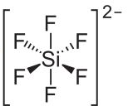
2. Removing oxides with flux preparations 2.1 Mode of action of flux preparations
I. Impurities in the melt
II. Impurities on furnace and crucible walls
IV. Impurities due to
foreign metals
III. Basics of flux preparations
Oxid
Fluxes bind oxides by means of fluorides
The interfacial tension between oxide and aluminium
is significantly higher
than the interfacial tension between oxide and fluoride.
2 Na⁺
e.g. sodium silicofluoride

Slide 12
2. Removing oxides with flux preparations 2.1 Mode of action of flux preparations
I. Impurities in the melt
II. Impurities on furnace and crucible walls
III. Basics of flux preparations
IV. Impurities due to
foreign metals
The lower energetic state therefore are fluorides adhering and coating oxides
Fluorine and oxide subsequently form mixing phases
Aluminium is separated from the mixing phase
2 Na⁺
e.g. sodium silicofluoride

Slide 13
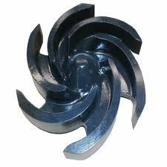
2. Removing oxides with flux preparations 2.2 Cleaning the melt with flux preparations
I. Impurities in the melt
II. Impurities on furnace and crucible walls
IV. Impurities due to
foreign metals
III. Basics of flux preparations
impeller-treatment
low-metal
dross
fluorides
cracking
mixing phase formation
cracking
reduction of
interfacial tension
2 Na⁺
dross
formation
dross
formation
Al
Al
Al
Al
Al
Al
Al
Al
Al
Al
Al₂O₃-film
gas bubbles

Slide 14
2. Removing oxides with flux preparations 2.3 No application of fluxes, impeller-treatment
I. Impurities in the melt
II. Impurities on furnace and crucible walls
IV. Impurities due to
foreign metals
III. Basics of flux preparations
impeller-treatment
Al
Al
Al
Al
Al
Al
dross
formation
Al
Al
metal-containing
dross
Al
Al
Al
Al
Al
Al
Al
Al
Al
Al
Al
Al
Al
Al₂O₃-film
Al₂O₃
gas bubbles

Slide 15
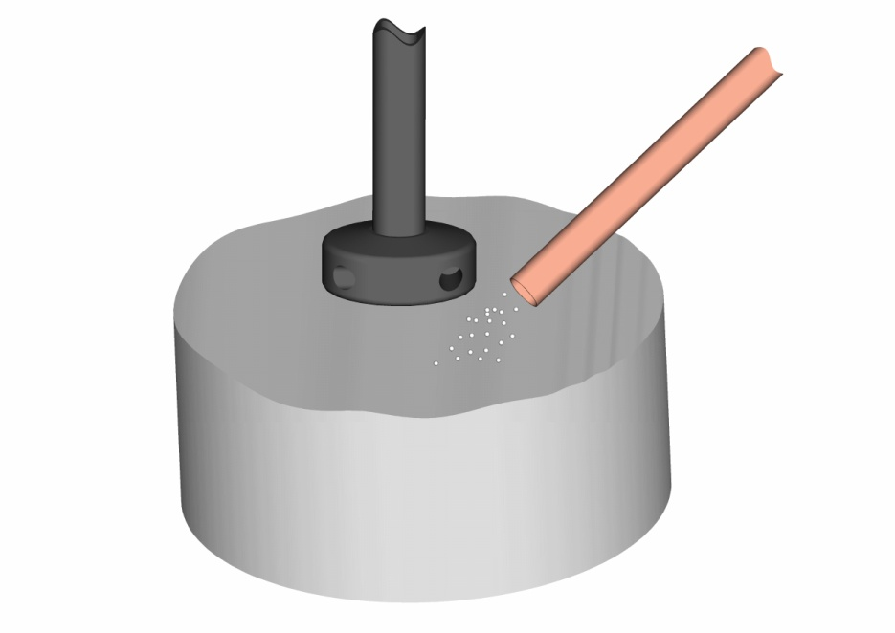
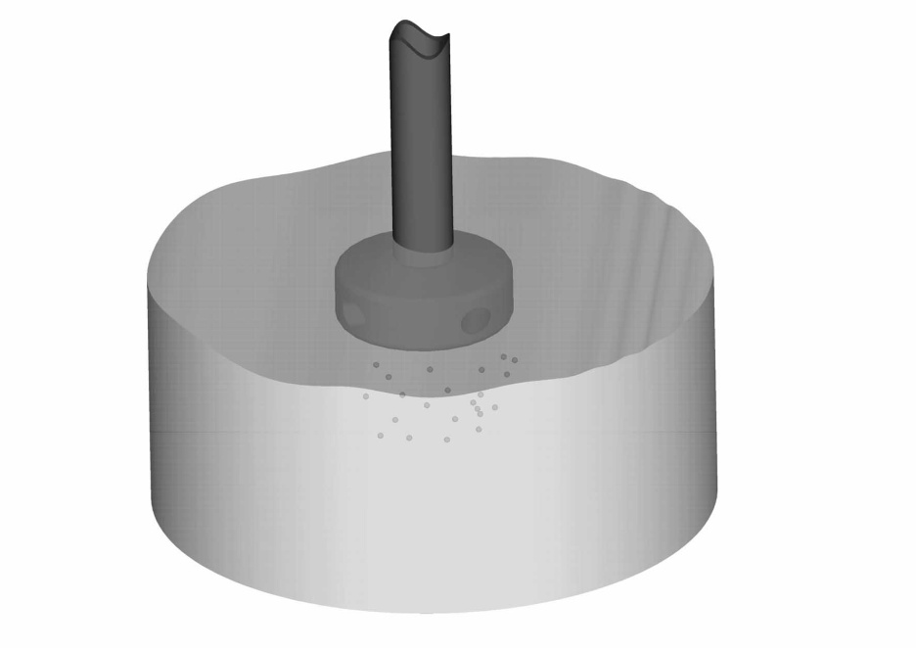
2. Removing oxides with flux preparations 2.4 Cleaning with impeller – wetting the flux with melt
I. Impurities in the melt
II. Impurities on furnace and crucible walls
IV. Impurities due to
foreign metals
III. Basics of flux preparations
Phase 1:
Start of the cleaning process by high rotation speed; formation of a funnel to generate a reaction with the impurities and the melt
Addition of cleaning agents such as powder, granulate for cleaning, refining and grain refinement

Slide 16
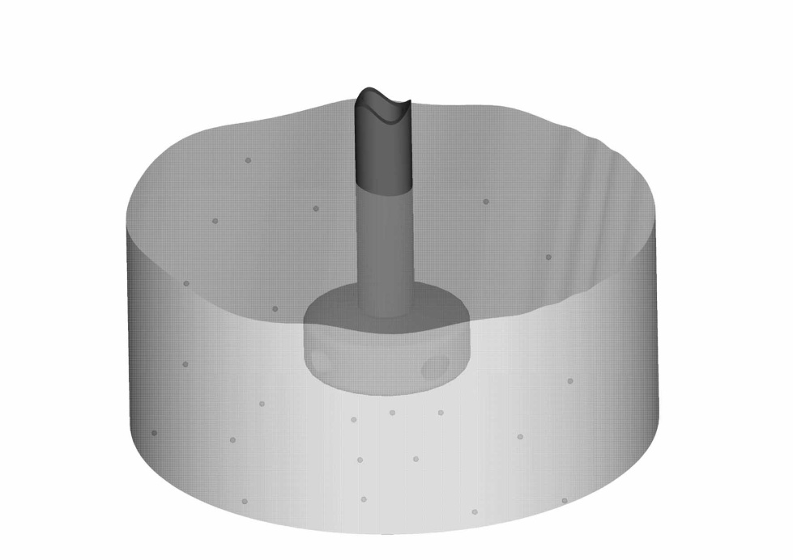
2. Removing oxides with flux preparations 2.4 Cleaning with impeller – Phase 2: Cleaning process
I. Impurities in the melt
II. Impurities on furnace and crucible walls
IV. Impurities due to
foreign metals
III. Basics of flux preparations
Cleaning process:
The rotor rotates in the opposite direction as the melt.
relative motion is extremely high (melt-rotor)
high efficiency, no formation of funnels
Once the melt rotates in the same direction as the rotor, the rotor changes its direction (this happens 3 or 4 times per cleaning process)
Improving the cleaning effectiveness
Notes:
It is quite important to know that for this mechanism no paddle is needed.

Slide 17
2. Removing oxides with flux preparations 2.5 Effects on the dross
I. Impurities in the melt
II. Impurities on furnace and crucible walls
IV. Impurities due to
foreign metals
III. Basics of flux preparations
Fluorides form mixing phases and adhere to the oxide because of the energetic low interfacial tension.
As a result:
Metal flows out of the dross
There is more metal available for casting
Saving potentials

Slide 18
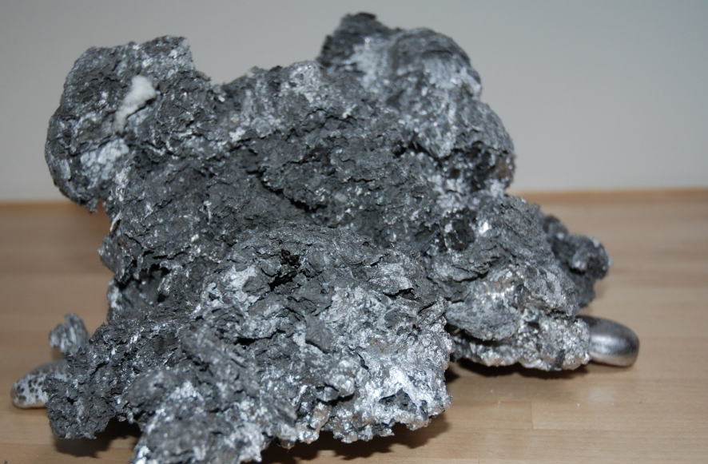
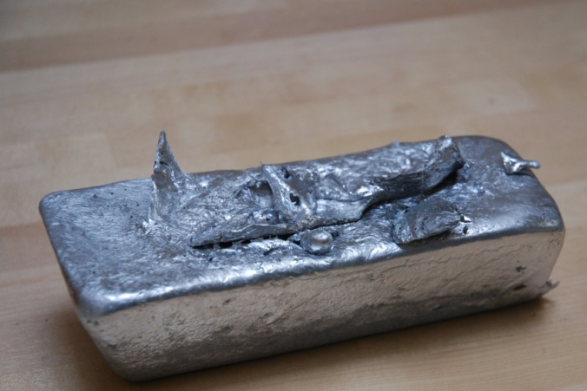
2. Removing oxides with flux preparations 2.6 Dross after impeller-treatment
I. Impurities in the melt
II. Impurities on furnace and crucible walls
IV. Impurities due to
foreign metals
III. Basics of flux preparations
Dross of an AlSi7Mg alloy
without using flux preparations
calculation:
1.500 g dross => 1.222 g metal
=> metal content of the dross 82%
Metal dissolved out of the dross

Slide 19
2. Removing oxides with flux preparations 2.6 Dross after impeller-treatment
I. Impurities in the melt
II. Impurities on furnace and crucible walls
IV. Impurities due to
foreign metals
III. Basics of flux preparations
Dross of an AlSi7Mg alloy
with using flux preparations
calculation:
1.184 g dross => 161 g metal
=> metal content of the dross 14%
Metal dissolved out of the dross

Slide 20
Mechanisms in the Cleaning of Aluminium Melts with Flux Preparations
I. Impurities in the melt
II. Impurities on furnace and crucible walls
IV. Impurities due to
foreign metals
III. Basics of flux preparations
Impurities in the melt
Impurities on furnace and crucible walls
Removing corundum with flux preparations
Basics of flux preparations
Impurities due to foreign metals

Slide 21
1. Removing corundum with flux preparations 1.1 Damage of the crucible wall by corundum
I. Impurities in the melt
II. Impurities on furnace and crucible walls
IV. Impurities due to
foreign metals
III. Basics of flux preparations
micro cracks in the crucible wall
Al
Al
Al
crucible wall
crucible wall
crucible wall
crucible wall
crucible wall
Al
Al
corundum
Al
Al
Al
corundum
Al
Al
Al
Al
corundum
oxides

Slide 22
1. Removing corundum with flux preparations 1.2 Typical casting defects caused by oxides
I. Impurities in the melt
II. Impurities on furnace and crucible walls
IV. Impurities due to
foreign metals
III. Basics of flux preparations
High pressure piece about 5cm
with oxide inclusion
Micrograph of the oxide and
corundum inclusion
Aluminium-oxide-
mixture
Aluminium alloy
corundum inclusion

Slide 23
1. Removing corundum with flux preparations 1.3 Agglomeration of oxides after cleaning the melt with fluxes
I. Impurities in the melt
II. Impurities on furnace and crucible walls
IV. Impurities due to
foreign metals
III. Basics of flux preparations
no formation of corundum
Al
Al
crucible wall
crucible wall
crucible wall
crucible wall
Al
Al
Al
Al
Al
Al
Al
Al
Al
oxides cracked by fluxes

Slide 24
1. Removing corundum with flux preparations 1.4 Agglomeration of oxides – furnace cleaning
I. Impurities in the melt
II. Impurities on furnace and crucible walls
IV. Impurities due to
foreign metals
III. Basics of flux preparations
furnace cleaning
formation of corundum
furnace wall
furnace wall
furnace wall
furnace wall
corundum
corundum
corundum
corundum
Al
Al
Al
Al
furnace cleaning agent

Slide 25
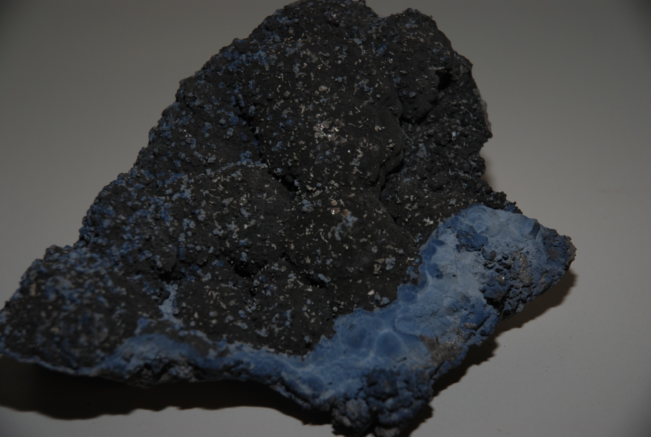
1. Removing corundum with flux preparations 1.5 Agglomeration of corundum
I. Impurities in the melt
II. Impurities on furnace and crucible walls
IV. Impurities due to
foreign metals
III. Basics of flux preparations

Slide 26
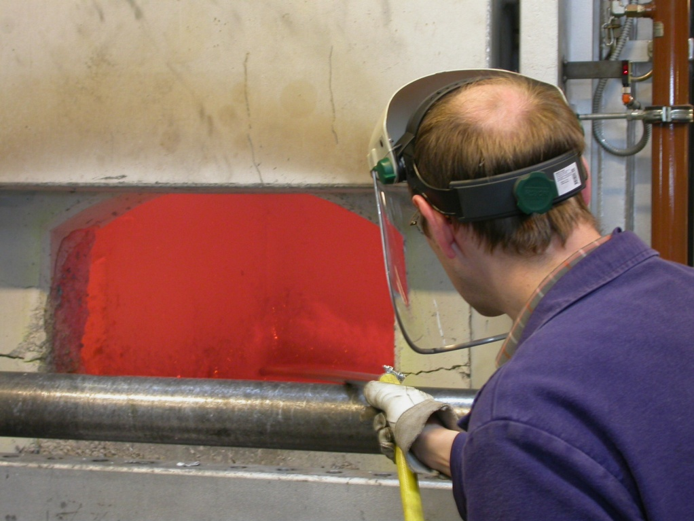
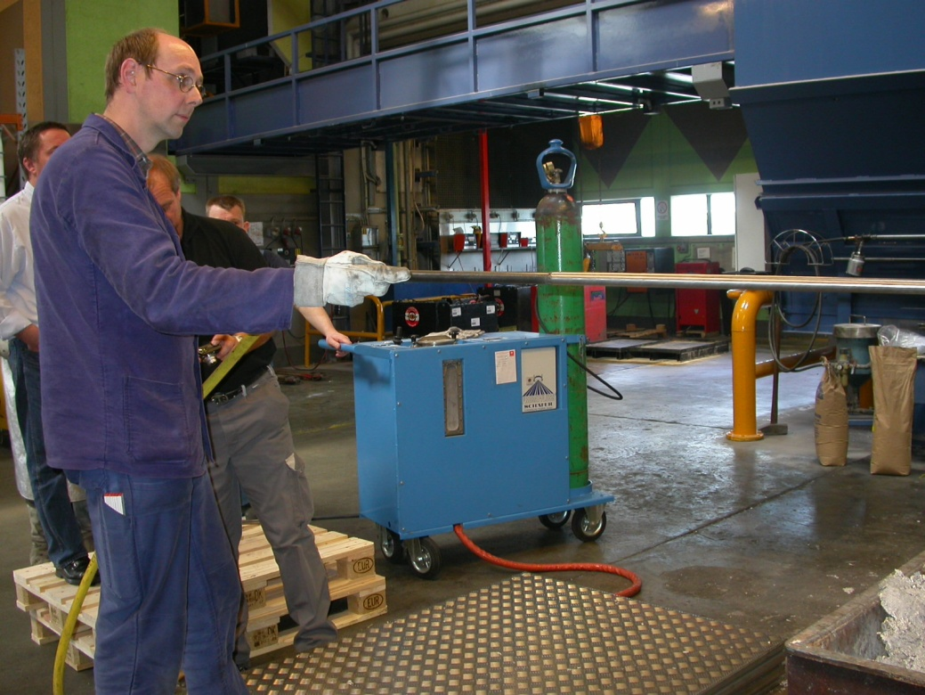
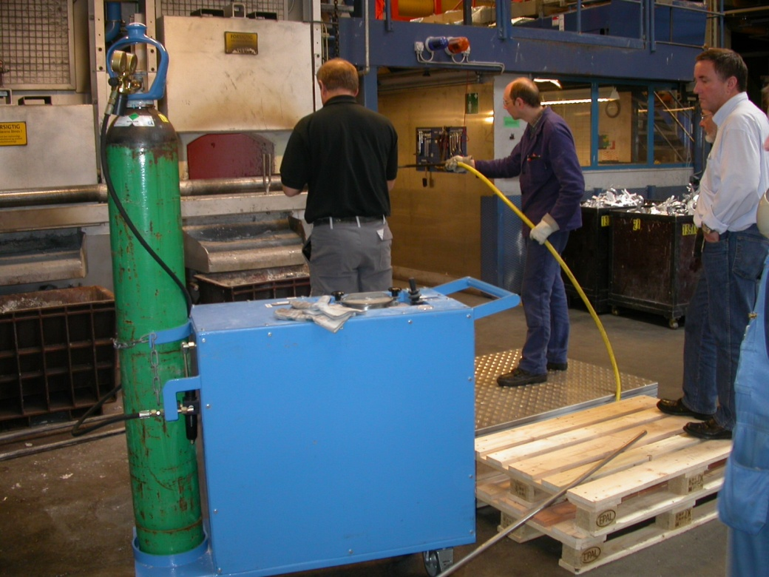
I. Impurities in the melt
II. Impurities on furnace and crucible walls
IV. Impurities due to
foreign metals
III. Basics of flux preparations
Removing agglomerations of corundum in hot furnaces

Slide 27
Mechanisms in the Cleaning of Aluminium Melts with Flux Preparations
I. Impurities in the melt
II. Impurities on furnace and crucible walls
IV. Impurities due to
foreign metals
III. Basics of flux preparations
Impurities in the melt
Impurities on furnace and crucible walls
Basics of flux preparations
Impurities due to foreign metals

Slide 28
1. Basics of flux preparations 1.1 Composition of flux preparations
I. Impurities in the melt
II. Impurities on furnace and crucible walls
IV. Impurities due to
foreign metals
III. Basics of flux preparations
Flux preparations consist of cations and anions
cations: e.g. sodium, potassium, calcium
anions: e.g. chloride, fluoride, aluminium fluoride, silico fluoride, carbonate, nitrate
cations are generally sodium or potassium
sodium: lower-cost but release of sodium
potassium: no effect on the metallurgy

Slide 29
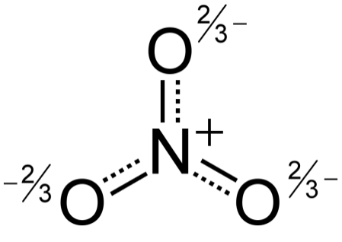
1. Basics of flux preparations 1.2 Exothermic fluxes
I. Impurities in the melt
II. Impurities on furnace and crucible walls
IV. Impurities due to
foreign metals
III. Basics of flux preparations
Exothermically reacting fluxes include nitrates
Nitrates oxidize aluminium by developing high heat (exothermic reaction)
It selectively reaches a temperature of approx. 2000°C in the dross
The high temperature causes a flow out of the aluminium from the dross
The low-metal dross is bought by an increased oxide formation

Slide 30
I. Impurities in the melt
II. Impurities on furnace and crucible walls
IV. Impurities due to
foreign metals
III. Basics of flux preparations
1. Basics of flux preparations 1.3 Effect of exothermic and fluoride containing fluxes
l
effect of
exothermic fluxes
effect of
fluoride containing fluxes
Al
Al
Al
Al
Al
Al
Al
crucible wall
Al
crucible wall
Al
Al
exothermic flux
fluoride containing flux

Slide 31
I. Impurities in the melt
II. Impurities on furnace and crucible walls
IV. Impurities due to
foreign metals
III. Basics of flux preparations
1. Basics of flux preparations 1.4 Types of sale
powder
granulate
loose mixture
losses due to the formation of dust
reacts only when mixed
slower reaction
higher volumes applied
lower price
compacted mixture
no environmental pollution
immediate reaction by liquefaction
more intensive reaction
lower volumes applied
slightly higher price
granulate
flakes

Slide 32
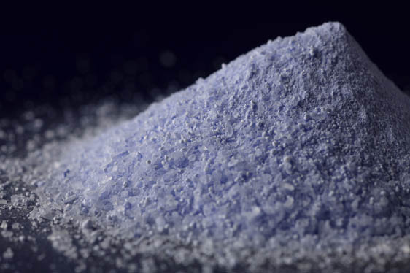
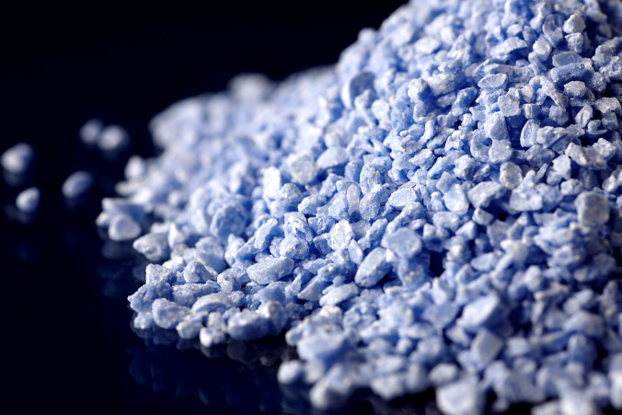
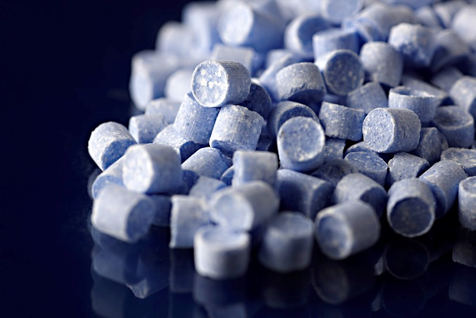
I. Impurities in the melt
II. Impurities on furnace and crucible walls
IV. Impurities due to
foreign metals
III. Basics of flux preparations
1. Basics of flux preparations 1.4 Types of sale
powder
flakes
granulate

Slide 33
Mechanisms in the Cleaning of Aluminium Melts with Flux Preparations
I. Impurities in the melt
II. Impurities on furnace and crucible walls
IV. Impurities due to
foreign metals
III. Basics of flux preparations
Impurities in the melt
Impurities on furnace and crucible walls
Basics of flux preparations
Impurities due to foreign metals

Slide 34
1. Chemical reaction with flux preparations
I. Impurities in the melt
II. Impurities on furnace and crucible walls
IV. Impurities due to
foreign metals
III. Basics of flux preparations
Removable foreign metals:
Li, Na, Mg, Ca, Sr
Foreign metals difficult to remove:
Fe, P, Ti, Sb
Removal with chlorine, chlorides or fluorides:
Formation of metal-chloride (with chlorine gas)
Formation of metal-chloride (with magnesium chloride)
Formation of metal-aluminium-fluorides

Slide 35
Furnace practice with flux preparations
I. Impurities in the melt
II. Impurities on furnace and crucible walls
IV. Impurities due to
foreign metals
III. Basics of flux preparations
Effects on the metallurgy
Removing oxides by flotation
➔ Reduction of oxidic inclusions and corundum
Removing metal out of the dross
➔ More metal is available for the casting process
Effects on furnace and crucible walls
No adherences or infiltration of walls
➔ Protection of crucibles and cladding if dosed properly

